Slide 1
Powerpoint Review

Slide 2
Copy and Paste the words to the correct color. Control C and Control V
Orange
Orange
Green
Yellow
Purple
Brown
Black
Pink
Grey
Blue

Slide 3
Cut and Paste the words to the correct color. Control X and Control V
Orange
Green
Yellow
Purple
Brown
Black
Pink
Grey
Blue

Slide 4
Format the font, size and color.
Orange
Green
Yellow
Purple
Brown
Black
Pink
Grey
Blue

Slide 5
Delete Slide 5.

Slide 6
Use Control + Z, the UNDO command, to bring back slide 5.

Slide 7
Delete the text box and picture below.

Slide 8
Delete the 2 extra sentences below.
How are you doing so far?
How are you doing so far?
How are you doing so far?

Slide 9
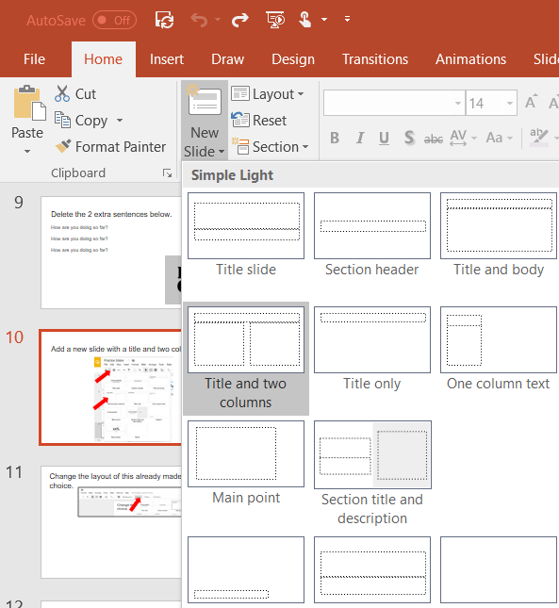
Add a new slide with a title and two columns.

Slide 10
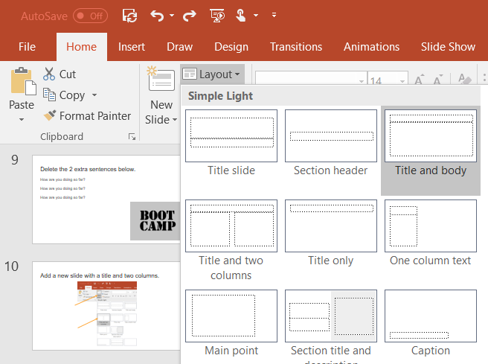
Change the layout of this already made slide to your choice.

Slide 11
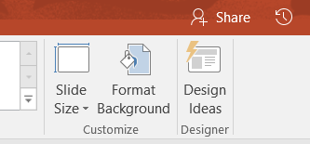
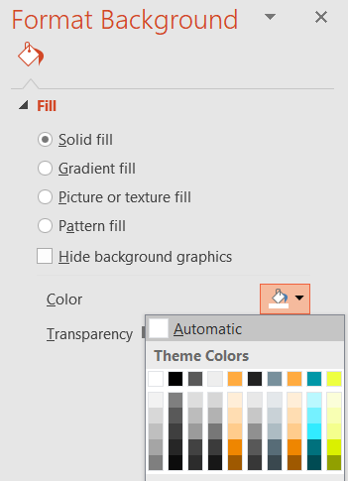
Change this slide background to the color orange.
1.
2.
3.

Slide 12
Change this slide background to an image of a park.
Add an image/picture of a park on this side.

Slide 13
Change the theme of all slides to your choice.

Slide 14
Congratulations! You did it!

