Slide 1
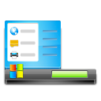
Build your Desktop
Build Your Own Computer
Fill the monitor frame with a color
Click and drag icons into place
© Brittany Washburn

Slide 2
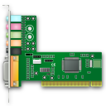
Build your Hardware
Build Your Own Computer
Fill the frame with a color.
Click and drag hardware parts into place and resize them to fill the spaces.
audio card
ROM
RAM
disk drive
fan
hard drive
© Brittany Washburn

Slide 3
Label your Browser
Build Your Own Computer
Click and drag the labels to the boxes.
Minimize, Maximize, and Close
Refresh
Home
Back and Forward
Search Bar
Bookmarks
Address Bar
© Brittany Washburn

Slide 4
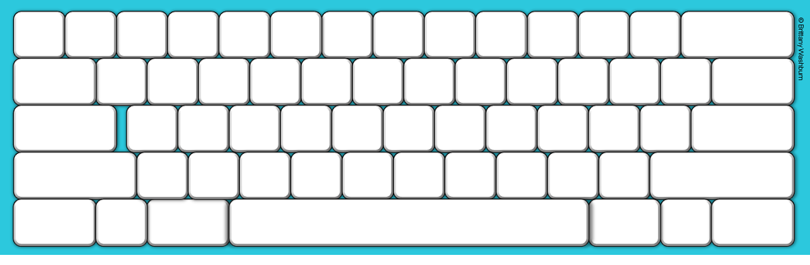
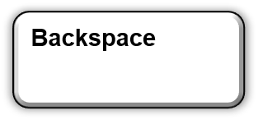
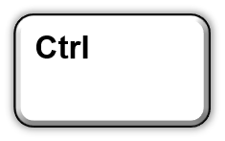
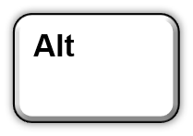
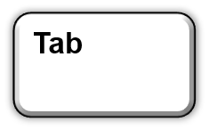
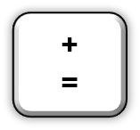
Build Your Own Computer
© Brittany Washburn
Build your Keyboard

